Slide 1
Au café – Role Play
Jeudi, 21 mai
Learning objective: To be able to act out a scene in a café

Slide 2
Dominoes!
Non, je voudrais aussi un coca s’il vous plait
Vous désirez ?
C’est 6 euros monsieur
C’est tout monsieur?
Merci, au revoir
Je voudrais une limonade s’il vous plait
Oui. C’est combien?
Au revoir
Oui, c’est tout?

Slide 3

Role play:
Working in pairs, decide who will be the waiter (serveur) and who will be the customer (client).
Use the script to create your conversation – you must have a completed copy of the script each and must include at least one food and one drink each time you ‘order’.
Use your menu as a prop (if you need to do more work on this, you can but only after you have completed your conversation).
Practice your role play to perform ‘at the cafe’
If you want to act using different emotions, you can (annoyed waiter, impatient client, happy waiter, etc.)

Slide 4
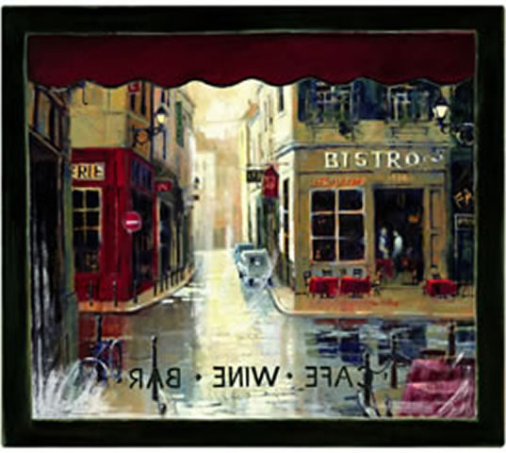
Chez Pritzlaff

